Slide 1

WORKING TOGETHER
UNDER A COOPERATIVE AGREEMENT
Tanya Shugar (ILAB)
Evan Hughes, Sue Levenstein, and Tam Nguyen (ETA/OGM)
FY 2020 New Grantee Orientation
Notes:
OGM - Welcome to the 2020 ILAB-OGM Grantee Orientation. First, let us introduce ourselves:
Tanya Shugar is a Division Chief managing projects taking place in the Africa region in the Bureau of International Labor Affairs (ILAB).
Evan Hughes is your Grant Officer in the Employment and Training Administration (ETA)’s Office of Grants Management (OGM).
Sue Levenstein and Tam Nguyen are grants management specialists who work with Evan in OGM.
We are here today to conduct the FY2020 New Grantee Orientation. So let’s get started.

Slide 2
Key players in the award
ILAB – Your Program Office
Grant Officer’s Representative (GOR), Division Chief
Project activities
Scope
Programmatic
Recipient Organization (Grantee)
Project Director
Project plan
Procurement Officer / Authorized Representative (AR or AOR)
Reviews, approvals, submissions
Office of Grants Management (OGM)
Grants Management Specialist (GMS), Grant Officer (GO)
Uniform Guidance (2 CFR 200)
Policy
Budget
Notes:
First, we’d like to give some background on our roles in implementing the award, more specifically, a cooperative agreement.
The U.S. government is the funder or “federal awarding agency” that is referred to in the Uniform Guidance, also known as 2 CFR 200.
The Bureau of International Labor Affairs, or ILAB, is the program office; your point of contact in ILAB is referred to as the Grant Officer’s Representative, or GOR. As parties to a cooperative agreement, ILAB has substantial involvement in the recipient’s project.
When an award is first issued or a revision or modification request requires the Grant Officer’s prior approval, ILAB’s GOR will make that request on the recipient’s behalf to the Grants Officer or Grants Management Specialist who work in the Office of Grants Management (OGM).
The recipient organization (also known as the “grantee” but for our purposes, we refer to them as the “recipient”) operates with a project team which consists of a project director (PD), or principal investigator (PI) who works closely with ILAB’s GOR. Furthermore, the Authorized Representative (AR) is responsible for approving all modification requests from the recipient organization before they get transmitted to ILAB/OGM for processing. Getting the AR’s approval on any modification request is important and will avoid hurdles later on.
Only the Grant Officer is authorized to make final decisions about project modifications and approval of budgets. But the Program Manager, acting as the GOR, does the initial review and has to recommend decisions taken by the Grants Officer. You will be working primarily with your PM/GOR and should not be sending things directly to the Grant Officer or Grant Specialist unless they’ve specifically asked for something.

Slide 3
Components of a Cooperative Agreement
Award/Modification cover page
Signature page / Notice of obligation (NOO)
Agreement/Modification
Terms and conditions
Budget/budget narrative
Statement of work (SOW)
Order of precedence
Notes:
What you see on this slide consists of the contents of an award modification.
This is what (at minimum) is sent and is part of the Documentation of the Cooperative Agreement. After award, we send out attachments including Notice of Award, Terms and Condition, Form SF-424 and 424A, Technical Proposal, Budget, Budget Narrative, Indirect cost support documents and Work Plan.
What are some things that it tells us?
Period of Performance
Total Government Financial Obligation
The expectations of the project

Slide 4
Modification
Approval process
Notes:
Now let us go over the approval process when you make a modification request.

Slide 5
Approval process
OCFT 2019 MPG, page 39, Annex PRF
Recognized by PD and the GOR (usually through the MPG)
Programmatic change
Key personnel
Implementation agreements with governments
Geographical location
Chart in the annex
Budget/administrative changes
Over threshold
New subs
Participant / beneficiary support costs
Other items of cost
Notes:
As you’ll see in some of the subsequent slides, we have included the reference source on the upper left-hand corner of the slide that encourages you to familiarize yourself with the Management Procedures & Guidelines (MPG).
To initiate an award modification, the recipient would submit the contents of a modification to the program office (ILAB) for review. This is most typically conducted through a consultation session (between the recipient and the GOR) either through a conference call, phone call, or via e-mail. The recipient may make multiple revisions prior to submission.
The most common types of modifications include:
Programmatic change such as key personnel or geographical location etc. (you can see more specific examples on the slide above);
Budget/admin change: no-cost extension, budget realignment, increase budget change (again, refer to the examples listed on the slide).

Slide 6
Approval process (cont’d)
Prior approval
The Grant Officer is the only official with the authority to provide prior written approval.
Submits to Grants Officer for final approval
Technical details…
Budget and budget narrative
CV / resume
Project narrative
How the change benefits the project
Notes:
All modifications require the Grant Officer’s prior approval.
The Grant Officer is the individual authorized to sign the award and therefore, has the ability to make revisions to the award. Please refer to the bottom of the terms and conditions page to see where this is being stated.
The Authorized Representative (AR) is the individual who authorizes approval of the project modification on behalf of the grantee organization. This individual’s name and signature could be found on the SF-424.
As previously mentioned, the GOR does the initial review of the modification draft but the Grant Officer performs the final review.
In conversations between the recipient and the Department of Labor, it is important for the recipient to clearly outline how the modification would benefit the project.

Slide 7
Examples of prior approval
OCFT 2019 MPG, page 23
“Programmatic Revisions”
2 CFR 200.308 examples
Change of key personnel
Re-budgeting
Adding subawards/subrecipients
Revising period of performance
Other items of cost
Revisions to the agreement
Programmatic change
Budget change
Exceptions to restrictions
Notes:
Here is a summary of what we had discussed, regarding some of the most common types of award modifications.
We have included some of the most common types of award modifications that require the application of 2 CFR 200.308, Revision of budget and program plans. This means that you should not only consult the MPG reference, which is listed on the upper left-hand corner of the slide, you are encouraged to consult the Uniform Guidance (2 CFR 200.308) if needed.

Slide 8
Modification
BUDGET REVISION
Notes:
Now let’s provide you with an overview of one of the most typical award modifications that we process—the budget revision modification.

Slide 9
Scenarios for a budget revision
OCFT 2019 MPG, page 23
Cost Increase
Sub-awarding
Transferring of funds budgeted for participant support costs to other categories of expense
Transfer of funds among direct-cost categories that exceeds or is expected to exceed 10 percent of the total budget as last approved by USDOL
Equipment purchase
Transfer of funds to host country governments
Changes to costs budgeted for capital expenditures
Notes:
Some of the most typical scenarios requiring a budget revision modification are bulleted here.
This includes:
Cost increase: the Grant Officer will review and approve all cost increases, however, the program office may additionally be required to have the Procurement Review Board (PRB) review the cost-increase request depending on the amount.
Sub-awarding: prior approval is required to add a subaward.
Participant support costs means direct costs for items such as stipends or subsistence allowances, travel allowances, and registration fees paid to or on behalf of participants or trainees (but not employees) in connection with conferences, or training projects. (2 CFR 200.75)
Transfer of funds among direct cost categories would need prior approval only if the total amount being transferred exceeds 10% of the federal funding total.
Capital expenditures for special purpose equipment are allowable as direct costs, provided that items with a unit cost of $5,000 or more have the prior written approval of the Federal awarding agency or pass-through entity. (2 CFR 200.439)
In sum, we would only review and approve budget revisions that fall into one of these scenarios that are also set forth in the MPG.

Slide 10
2 CFR 200 Reference
OCFT 2019 MPG, page 23
“Programmatic Revisions”
§200.308 Revision of budget and program plans.
§200.407 Prior written approval (prior approval).
Notes:
We recommend two listed guidelines from the Uniform Guidance—2 CFR 200.308, Revision of budget and program plans and 2 CFR 200.407, Prior written approval—to better inform you in terms of deciding whether or not a modification request is necessary.

Slide 11
Cost Principles
2 CFR 200 Subpart E
Allowable
Is it allowable under 2 CFR 200, the appropriation, and program requirements?
Allocable
Does it belong to the project, budget?
Reasonable
Is it necessary for the project, and does it seem reasonable?
Consideration of costs
Consistent (federal and non-federal funds, direct and indirect)
Conforming (with laws, regulations, policy, guidance, internal SOPs)
Documented
Notes:
Costs associated with the federal project need to be allowable, allocable and reasonable. When evaluating a project expense, it makes sense to ask the question associated with each category above:
Allowable: Is it allowable under 2 CFR 200, the appropriation, and program requirements?
Allocable: Does it belong to the project budget? A cost is allocable to a particular Federal award or other cost objective if the goods or services involved are chargeable or assignable to that Federal award or cost objective in accordance with relative benefits received.
Reasonable: Is it necessary for the project, and does it seem reasonable? A cost is reasonable if, in its nature and amount, it does not exceed that which would be incurred by a prudent person under the circumstances prevailing at the time the decision was made to incur the cost.
In considering project costs, it’s important to evaluate them in the context of consistency, conformity, and documentation (more details outlined in the slide above).

Slide 12
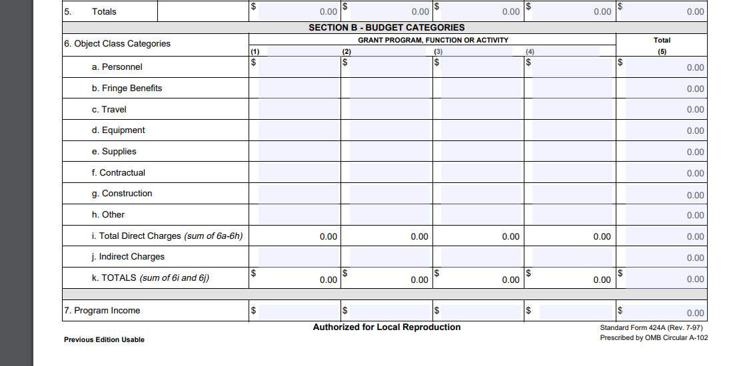
Determining the 10 percent budget threshold
Notes:
This particular example applies to budget revision modifications only.
In order to determine if prior approval is needed, please formulate your budget categories based on the SF-424A form, including the original budget category totals, the revised totals, and the dollar change between these amounts for each of these categories. This will help us better determine if the 10% threshold has been reached.

Slide 13
Example 1
OCFT 2019 MPG, page 22
“Programmatic Revisions”
Cost Category | Original Budget | Revised Budget | Difference
Personnel | $500,000.00 | $410,000.00 | -$90,000.00
Fringe Benefits | $250,000.00 | $275,000.00 | $25,000.00
Travel | $500,000.00 | $600,000.00 | $100,000.00
Equipment | $10,000.00 | $5,000.00 | -$5,000.00
Supplies | $50,000.00 | $40,000.00 | -$10,000.00
Contractual | $345,000.00 | $345,000.00 | $0.00
Construction | $0.00 | $0.00 | $0.00
Other | $25,000.00 | $5,000.00 | -$20,000.00
Total Direct Charges | $1,680,000.00 | $1,680,000.00 | $0.00
Indirect Charges | $320,000.00 | $320,000.00 | $0.00
Totals | $2,000,000.00 | $2,000,000.00 | $0.00
Notes:
Here is an example where we wouldn’t need a revision for 10 percent since the amount being transferred is under $200,000 ($125,000).

Slide 14
Example 2
OCFT 2019 MPG, page 22
“Programmatic Revisions”
Cost Category | Original Budget | Revised Budget | Difference
Personnel | $500,000.00 | $750,000.00 | $250,000.00
Fringe Benefits | $250,000.00 | $375,000.00 | $125,000.00
Travel | $500,000.00 | $200,000.00 | -$300,000.00
Equipment | $10,000.00 | $5,000.00 | -$5,000.00
Supplies | $50,000.00 | $60,000.00 | $10,000.00
Contractual | $345,000.00 | $285,000.00 | -$60,000.00
Construction | $0.00 | $0.00 | $0.00
Other | $25,000.00 | $5,000.00 | -$20,000.00
Total Direct Charges | $1,680,000.00 | $1,680,000.00 | $0.00
Indirect Charges | $320,000.00 | $320,000.00 | $0.00
Totals | $2,000,000.00 | $2,000,000.00 | $0.00
Notes:
Here we would need a revision for exceeding the 10 percent since the amount transferred is over 10 percent ($385,000).

Slide 15
Example 3
OCFT 2019 MPG, page 22
“Programmatic Revisions”
Cost Category | Original Budget | Revised Budget | Difference
Personnel | $500,000.00 | $450,000.00 | -$50,000.00
Fringe Benefits | $250,000.00 | $225,000.00 | -$25,000.00
Travel | $500,000.00 | $475,000.00 | -$25,000.00
Equipment | $10,000.00 | $35,000.00 | $25,000.00
Supplies | $50,000.00 | $25,000.00 | -$25,000.00
Contractual | $345,000.00 | $445,000.00 | $100,000.00
Construction | $0.00 | $0.00 | $0.00
Other | $25,000.00 | $25,000.00 | $0.00
Total Direct Charges | $1,680,000.00 | $1,680,000.00 | $0.00
Indirect Charges | $320,000.00 | $320,000.00 | $0.00
Totals | $2,000,000.00 | $2,000,000.00 | $0.00
Notes:
Here we would not need a revision for the 10 percent budget threshold. However, we would likely need a revision for equipment and perhaps contractual. Since both the budget lines for equipment and contractual have increased in the revision, and since the purchase of additional equipment as well as any new subaward requires prior approval as noted earlier in this presentation, we would want to seek additional information if it was not provided.

Slide 16
Example 4
OCFT 2019 MPG, page 22
“Programmatic Revisions”
Cost Category | Original Budget | Revised Budget | Difference
Personnel | $500,000.00 | $600,000.00 | $100,000.00
Fringe Benefits | $250,000.00 | $300,000.00 | $50,000.00
Travel | $500,000.00 | $300,000.00 | -$200,000.00
Equipment | $10,000.00 | $10,000.00 | $0.00
Supplies | $50,000.00 | $100,000.00 | $50,000.00
Contractual | $345,000.00 | $345,000.00 | $0.00
Construction | $0.00 | $0.00 | $0.00
Other | $25,000.00 | $25,000.00 | $0.00
Total Direct Charges | $1,680,000.00 | $1,680,000.00 | $0.00
Indirect Charges | $320,000.00 | $320,000.00 | $0.00
Totals | $2,000,000.00 | $2,000,000.00 | $0.00
Notes:
Here, it is exactly 10 percent. While this wouldn’t merit formal approval, the recipient should be on alert because any additional transfer between cost categories would necessitate formal approval, e.g., transferring any more funds from Travel to Supplies or Other. Conversely, if the recipient were to decide on the need to transfer any categories back, that would lessen the chance of requiring formal approval, e.g., later, before submitting a revised budget, the recipient decides to transfer funds back from Personnel to Travel, that would in essence, buy them some additional leeway for transfer going forward.

Slide 17
Financial monitoring
FedEral financial report (FFR) AND
payment management system (PMS) report

Slide 18
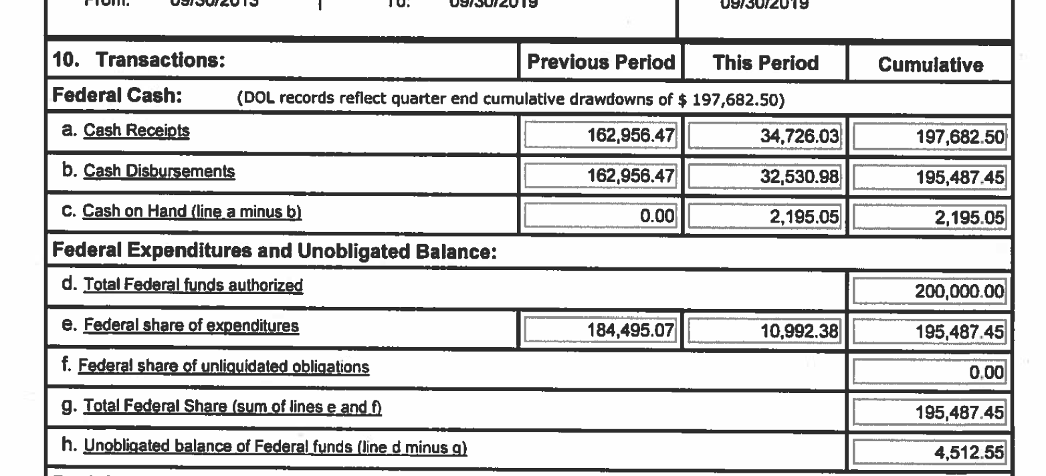
Final Financial Report
Notes:
The following slides will address the documents required for the closeout process.
This slide features a sample closeout Federal Financial Report (FFR), also known as the SF-425. This FFR is different from the “final” FFR quarterly report, as in it has all the finalized amounts of the project, including the amount that the recipient is expected to return to the U.S. Treasury.
Referring to the slide above, please ensure that:
The de-obligation balance (line 10h) is accurate;
Cash on Hand (line 10c) is zeroed out ($0.00);
Total Federal funds authorized (line 10d) should match with the authorized value on the recipient’s PMS report;
Total Federal Share (line 10g) should match with the recipient’s PMS report’s Snapshot Disburse value and Snapshot Charge value.

Slide 19
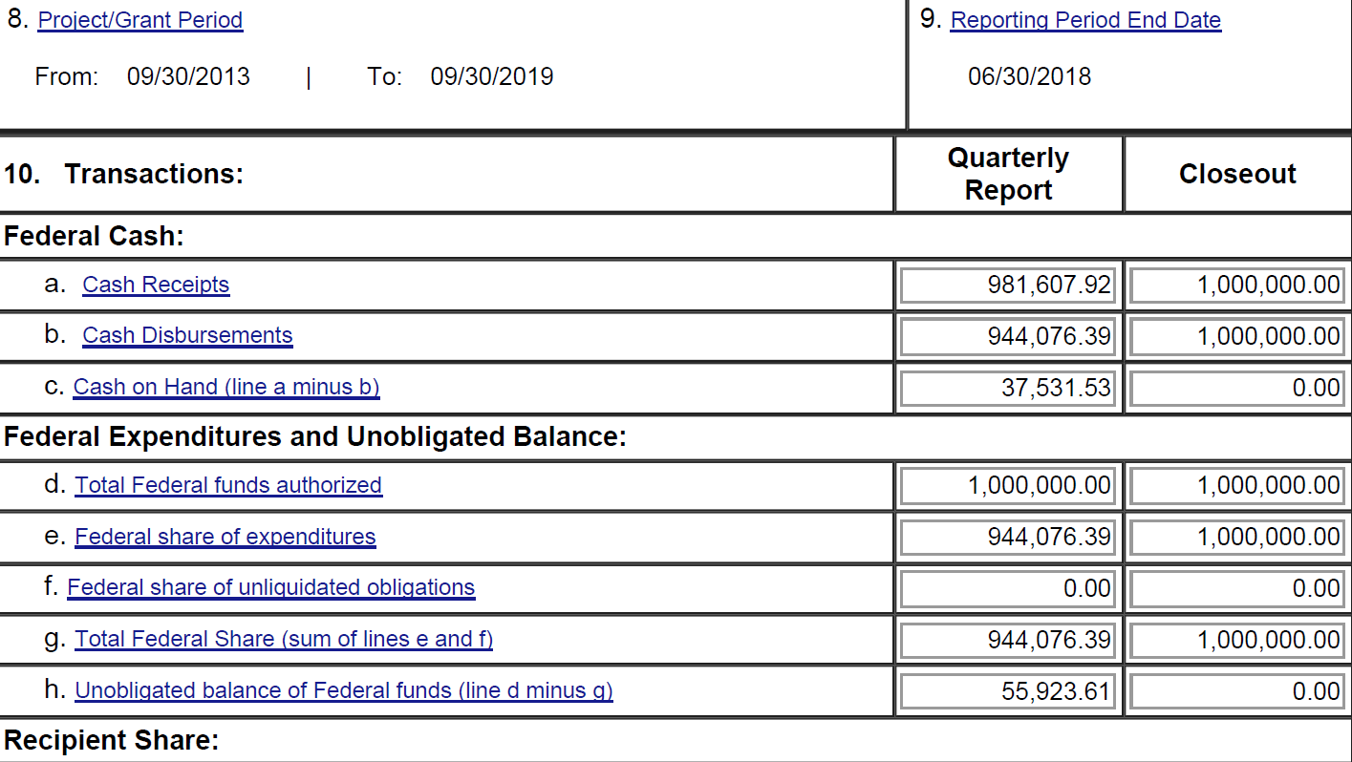
Final Financial Report (cont’d)
Notes:
This slide presents a sample FFR with an Cash on Hand balance of $0.00 (line 10c). It is important for the amount to be zeroed out to ensure that closeout can take place.

Slide 20
Payment Management System (PMS) report
*ACCT** *PIN* ****EIN***** *****DUNS***** ********Organization Name********
A1122P1 A1122 1529825802A4 605445980 INTERNATIONAL LABOR ORGANZATION
HHS-REG: 03 STATE: DC PMT: ACH STOP: N MAN-REV: N 272: File GROUP: F76 USER: VNK8NDD
AGY* *******GRANT******** *****AUTHORIZED**** *****DISBURSED**** ******CHG-ADV***** *RPT DISB* RS DS RI CT
****EIN***** *****FUTURE AUTH*** ***SNAPSHOT DISB** ***SNAPSHOT CHRG** *****SUBACCT********
T IL24943C55 250,000.00 250,000.00 12,874.00 09/30/2019 I O N 1
1529825802A4 .00 250,000.00 12,874.00 IL24943C55
*****AUTHORIZED**** *****DISBURSED**** ******CHG-ADV*****
*****FUTURE AUTH*** ***SNAPSHOT DISB** ***SNAPSHOT CHRG**
TOTAL: 250,000.00 250,000.00 12,874.00
.00 250,000.00 12,874.00 HITS: 1
OPEN & CLOSED: 688,845,709.38 655,961,326.54 657,814,461.46 CT: 277
OPEN: 135,627,454.00 102,743,071.16 104,596,206.08 CT: 41
CLOSED: 553,218,255.38 553,218,255.38 553,218,255.38 CT: 236
Notes:
Here is a sample page of a recipient’s PMS report.
When reviewing this report during closeout, make sure that the amounts being reported under “Snapshot Disb” and “Snapshot Chrg” have matching values.

Slide 21
Key Takeaways
We’re here to provide technical assistance
Communicate early and often
Approvals and modifications take time
The Terms and Conditions are the specifics of your award and the MPG should be a constant resource
2 CFR 200 - https://www.ecfr.gov/cgi-bin/text-idx?tpl=/ecfrbrowse/Title02/2cfr200_main_02.tpl
Questions?
Notes:
Also, there are lots of resources out there on the web, and even trainings, that cover management of federal awards, whether grants or cooperative agreements (rules for contracts are different!) Bookmark the Uniform Guidance!
If you have any questions or need further information, our e-mail addresses are listed below:
Tanya Shugar
Shugar.Tanya@dol.gov
Evan Hughes
Hughes.Evan.H@dol.gov
Sue Levenstein
Levenstein.Susan.L@dol.gov
Tam Nguyen
Nguyen.Tam-Thao.H@dol.gov

